Slide 1

@jessrudder youtube.com/compchomp

Slide 2
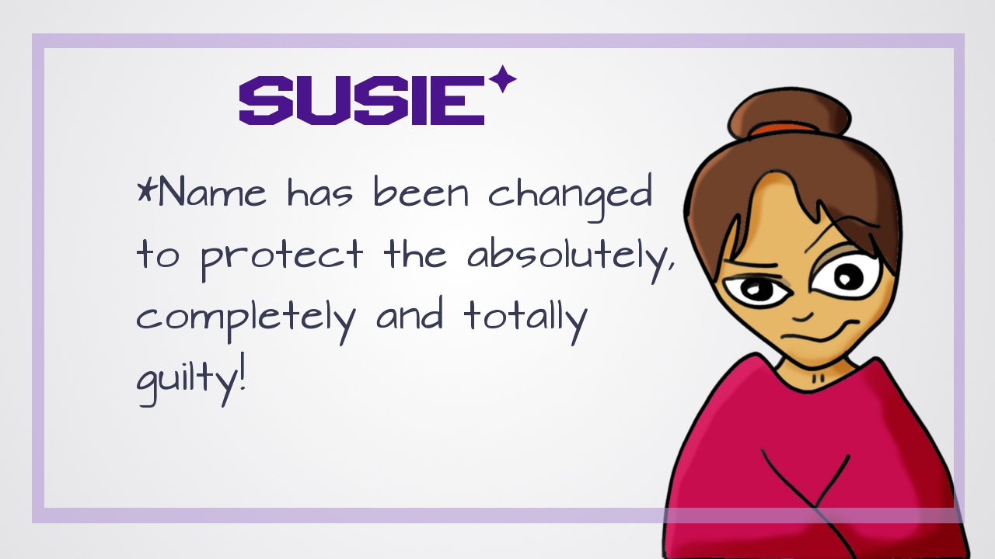
@jessrudder youtube.com/compchomp

Slide 3

@jessrudder youtube.com/compchomp

Slide 4
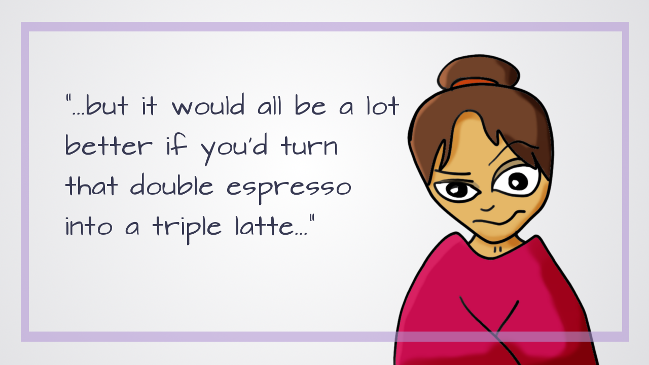
@jessrudder youtube.com/compchomp

Slide 5
@jessrudder youtube.com/compchomp

Slide 6

@jessrudder youtube.com/compchomp

Slide 7

@jessrudder youtube.com/compchomp

Slide 8

@jessrudder youtube.com/compchomp

Slide 9

@jessrudder youtube.com/compchomp

Slide 10


Slide 11


Slide 12

@jessrudder youtube.com/compchomp

Slide 13

@jessrudder youtube.com/compchomp

Slide 14
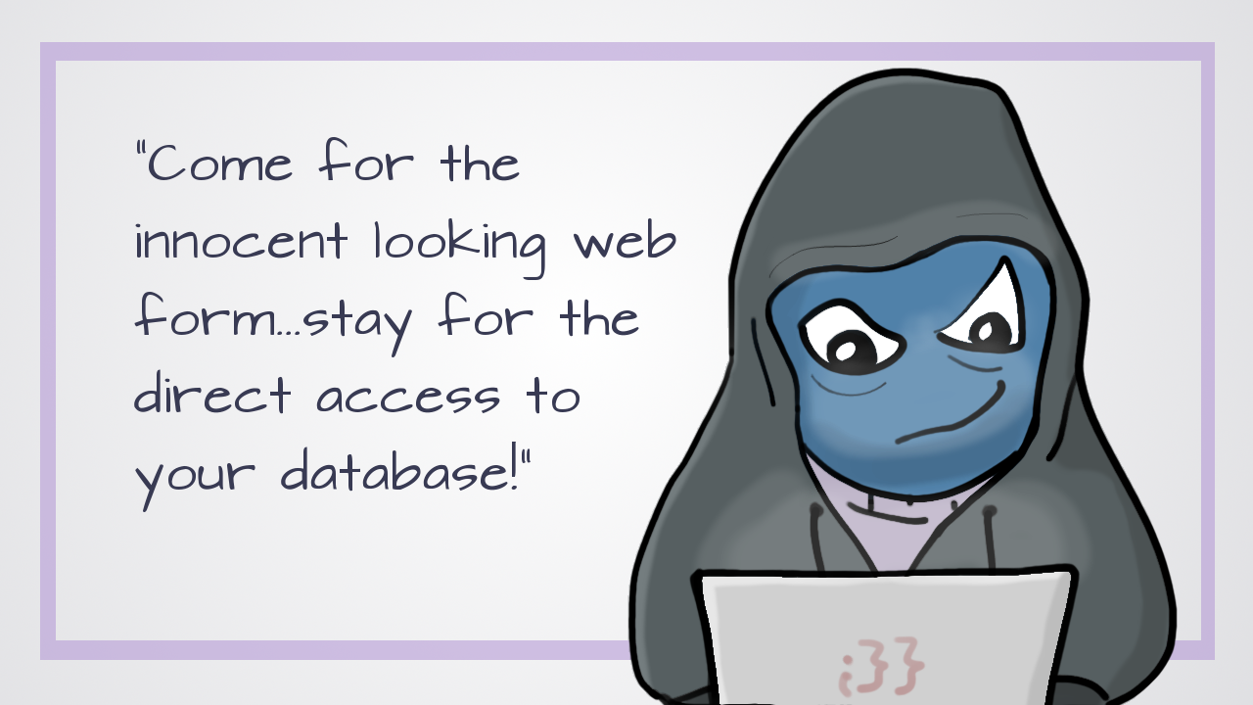

Slide 15

@jessrudder youtube.com/compchomp

Slide 16

@jessrudder youtube.com/compchomp

Slide 17

@jessrudder youtube.com/compchomp

Slide 18

@jessrudder youtube.com/compchomp

Slide 19

@jessrudder youtube.com/compchomp

Slide 20

@jessrudder youtube.com/compchomp

Slide 21

@jessrudder youtube.com/compchomp

Slide 22

@jessrudder youtube.com/compchomp

Slide 23

@jessrudder youtube.com/compchomp

Slide 24
@jessrudder youtube.com/compchomp

Slide 25

@jessrudder youtube.com/compchomp

Slide 26

@jessrudder youtube.com/compchomp

Slide 27


Slide 28


Slide 29

@jessrudder youtube.com/compchomp

Slide 30

@jessrudder youtube.com/compchomp

Slide 31

@jessrudder youtube.com/compchomp

Slide 32

@jessrudder youtube.com/compchomp

Slide 33

@jessrudder youtube.com/compchomp

Slide 34

@jessrudder youtube.com/compchomp

Slide 35
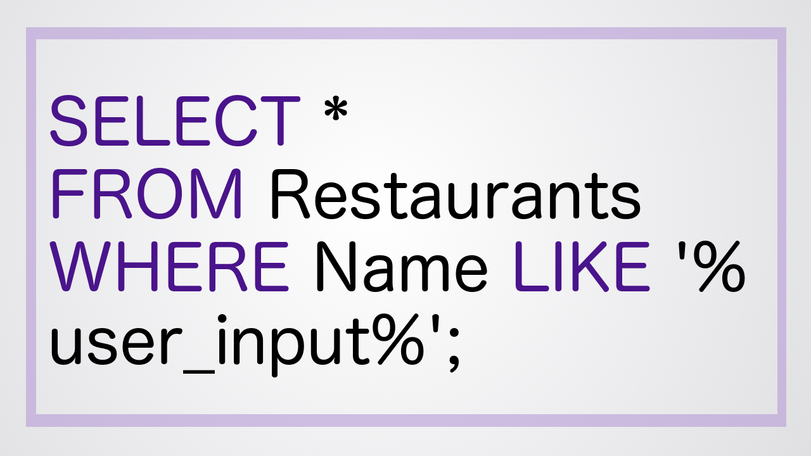
@jessrudder youtube.com/compchomp

Slide 36

@jessrudder youtube.com/compchomp

Slide 37
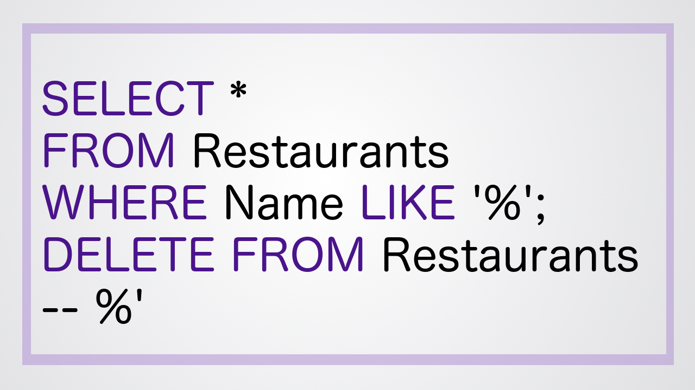
@jessrudder youtube.com/compchomp

Slide 38

@jessrudder youtube.com/compchomp

Slide 39

@jessrudder youtube.com/compchomp

Slide 40

@jessrudder youtube.com/compchomp

Slide 41

@jessrudder youtube.com/compchomp

Slide 42

@jessrudder youtube.com/compchomp

Slide 43

@jessrudder youtube.com/compchomp

Slide 44

@jessrudder youtube.com/compchomp

Slide 45

@jessrudder youtube.com/compchomp

Slide 46

@jessrudder youtube.com/compchomp

Slide 47

@jessrudder youtube.com/compchomp

Slide 48

@jessrudder youtube.com/compchomp

Slide 49

@jessrudder youtube.com/compchomp

Slide 50

@jessrudder youtube.com/compchomp

Slide 51

@jessrudder youtube.com/compchomp

Slide 52

@jessrudder youtube.com/compchomp

Slide 53

@jessrudder youtube.com/compchomp

Slide 54

@jessrudder youtube.com/compchomp

Slide 55

@jessrudder youtube.com/compchomp

Slide 56

@jessrudder youtube.com/compchomp

Slide 57

@jessrudder youtube.com/compchomp

Slide 58

@jessrudder youtube.com/compchomp

Slide 59


Slide 60

@jessrudder youtube.com/compchomp

Slide 61

@jessrudder youtube.com/compchomp

Slide 62
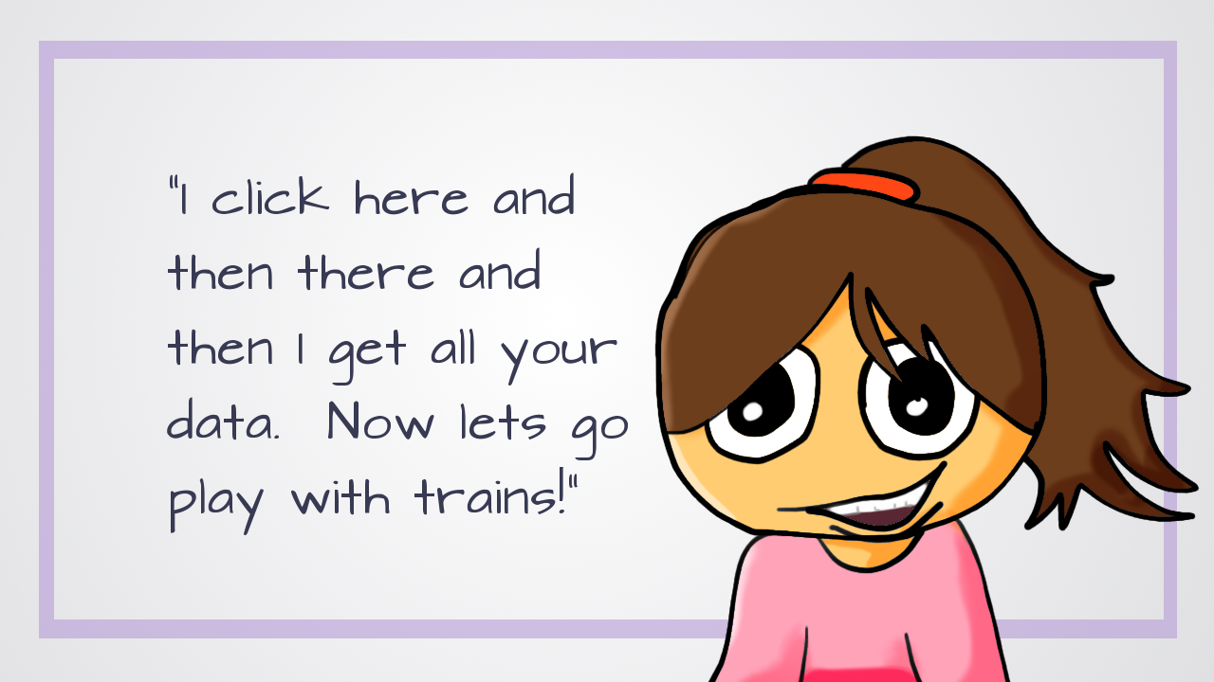

Slide 63

@jessrudder youtube.com/compchomp

Slide 64

@jessrudder youtube.com/compchomp

Slide 65


Slide 66

@jessrudder youtube.com/compchomp

Slide 67

@jessrudder youtube.com/compchomp

Slide 68
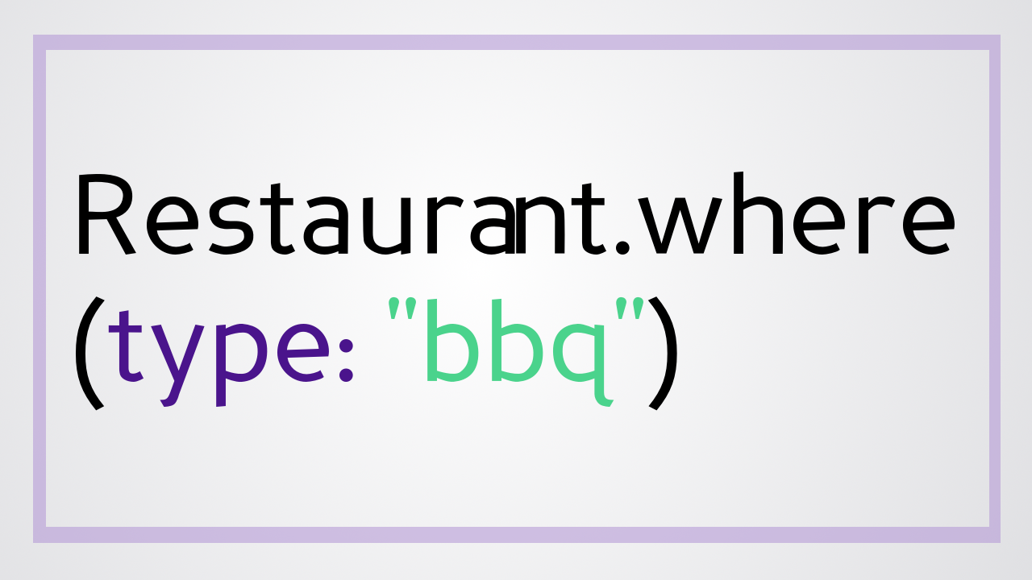
@jessrudder youtube.com/compchomp

Slide 69

@jessrudder youtube.com/compchomp

Slide 70


Slide 71

@jessrudder youtube.com/compchomp

Slide 72

@jessrudder youtube.com/compchomp

Slide 73

@jessrudder youtube.com/compchomp

Slide 74

@jessrudder youtube.com/compchomp

Slide 75

@jessrudder youtube.com/compchomp
Notes:
Only looking for an integer that matches a record in the database, so, raw sql would cause an error. However, someone could mess around with the number and still get access to records they shouldn’t have access to. So make sure you’re checking if the current user should have access to the record. That’s outside of the scope of this talk though, so I’m going to move right along….

Slide 76
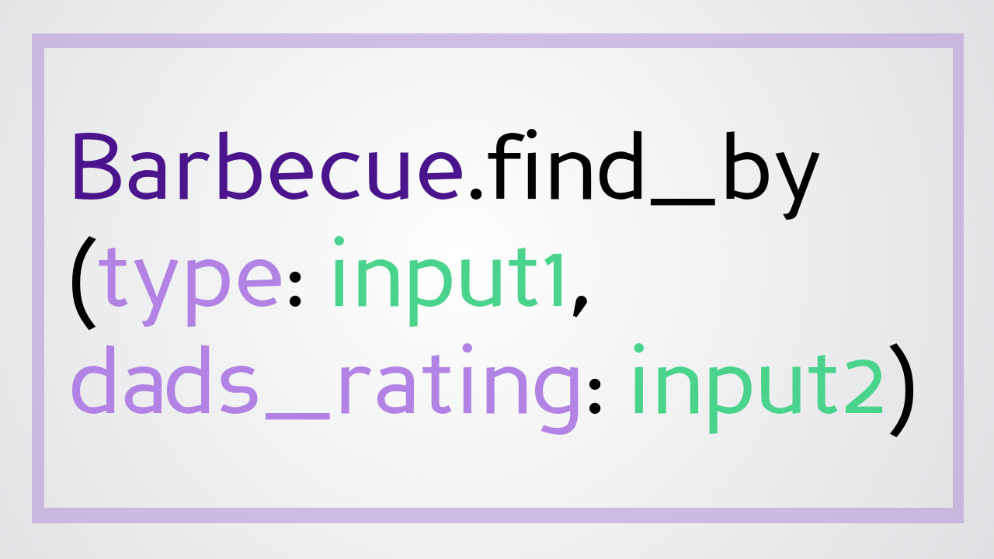
@jessrudder youtube.com/compchomp

Slide 77
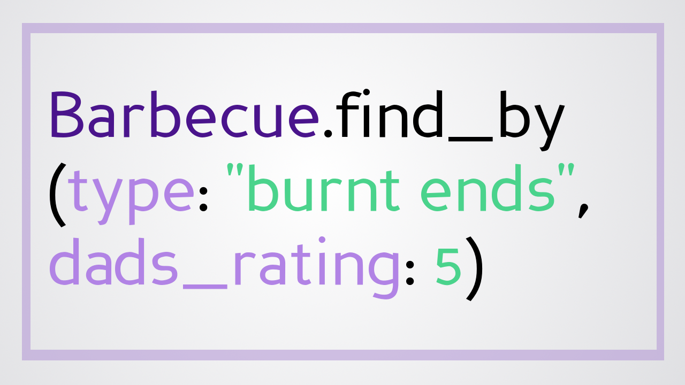
@jessrudder youtube.com/compchomp

Slide 78
@jessrudder youtube.com/compchomp
Notes:
when passed in as a hash, AR escapes special characters and treats the entire thing like a string so even if you pass in some SQL it won't execute

Slide 79
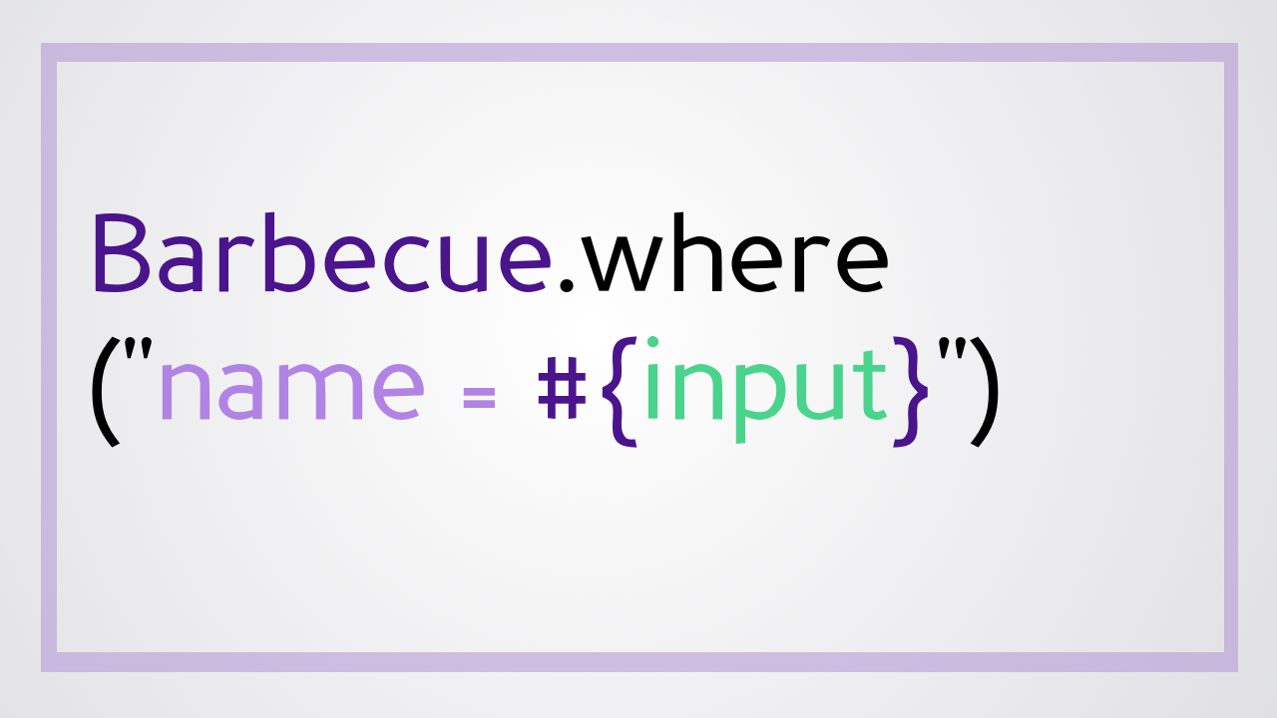
@jessrudder youtube.com/compchomp

Slide 80
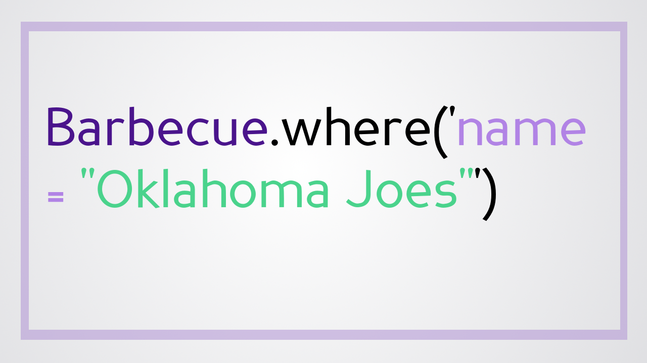
@jessrudder youtube.com/compchomp

Slide 81

@jessrudder youtube.com/compchomp

Slide 82
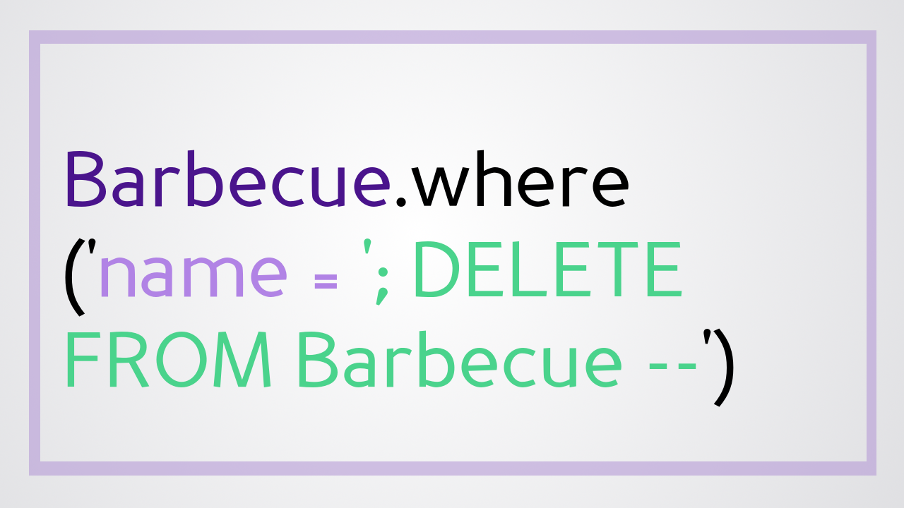
@jessrudder youtube.com/compchomp

Slide 83
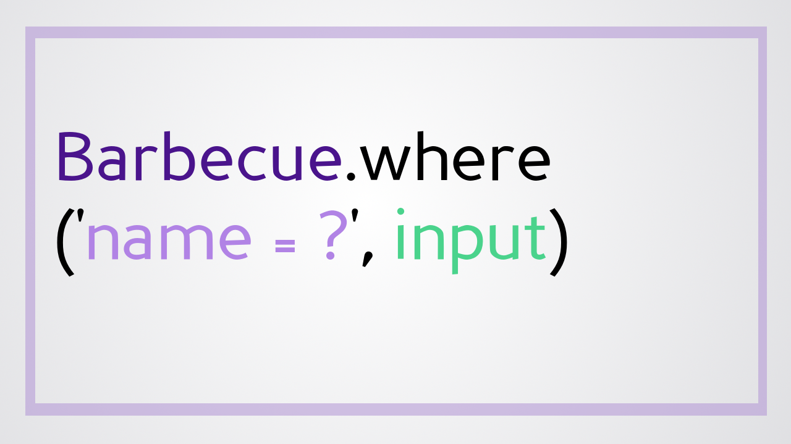
@jessrudder youtube.com/compchomp

Slide 84

@jessrudder youtube.com/compchomp

Slide 85

@jessrudder youtube.com/compchomp
Notes:
1) Sanitize User Input - escape the special characters
Magic happens in active_record/sanitization.rb with help from quoting.rb Basically it escapes all of the special characters so the query is sent in as nothing more than a simple string.

Slide 86

@jessrudder youtube.com/compchomp
Notes:
sql statement is sent to the database with placeholders for the question marks. Database parses the statement and comes up with a query plan that is cached for future use. A token is sent back to the app representing that query plan. When the actual values come through, the app sends the query token and the values to the database. This adds extra security because the database won't veer off the preset path. Info from the user is treated as simple statements and can't change the type of queries that are being made.
some don't support it - so the database adapter determines what to do when you send in a parameterized query.

Slide 87
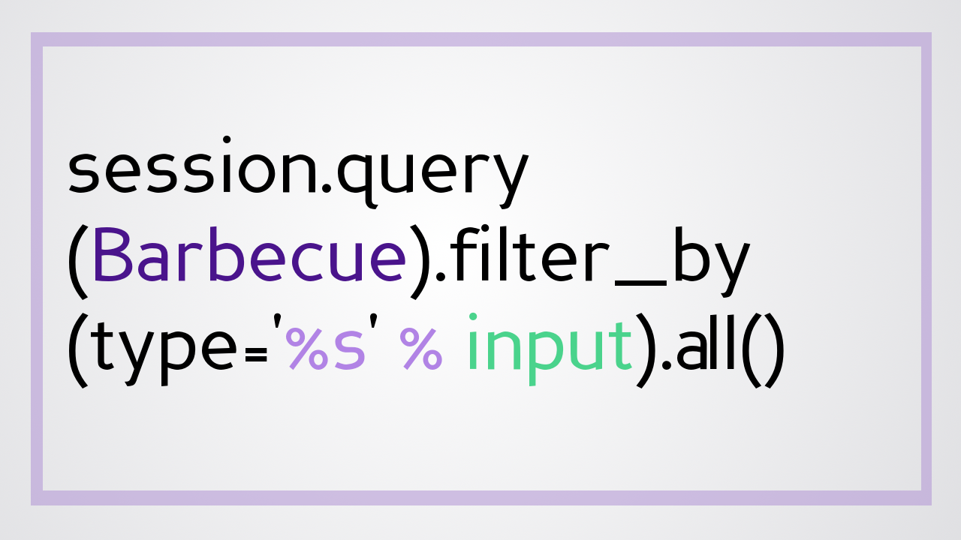
@jessrudder youtube.com/compchomp

Slide 88

@jessrudder youtube.com/compchomp

Slide 89
@jessrudder youtube.com/compchomp
Notes:
when passed in as a hash, AR escapes special characters and treats the entire thing like a string so even if you pass in some SQL it won't execute

Slide 90
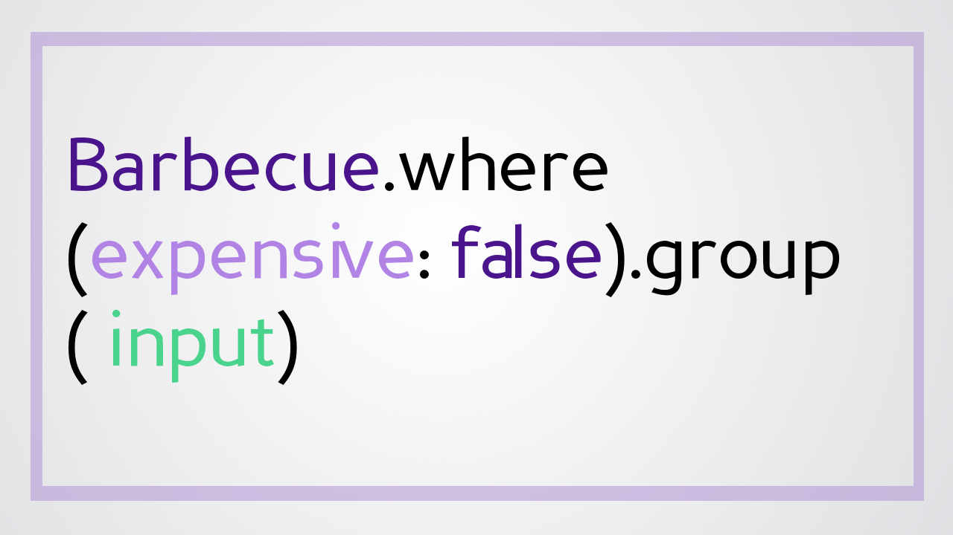
@jessrudder youtube.com/compchomp

Slide 91
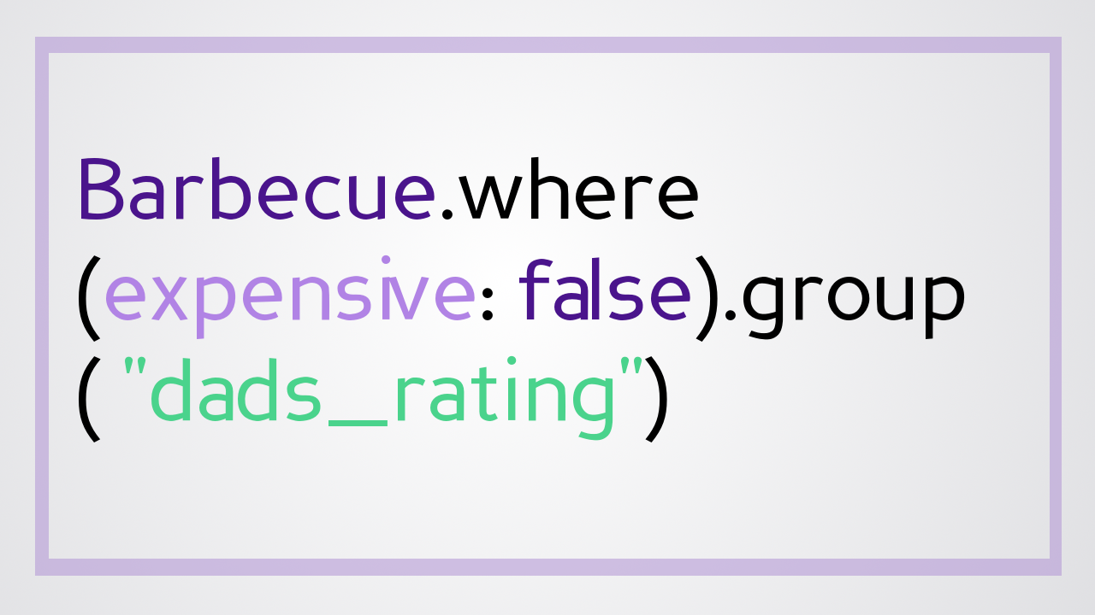
@jessrudder youtube.com/compchomp

Slide 92
@jessrudder youtube.com/compchomp

Slide 93
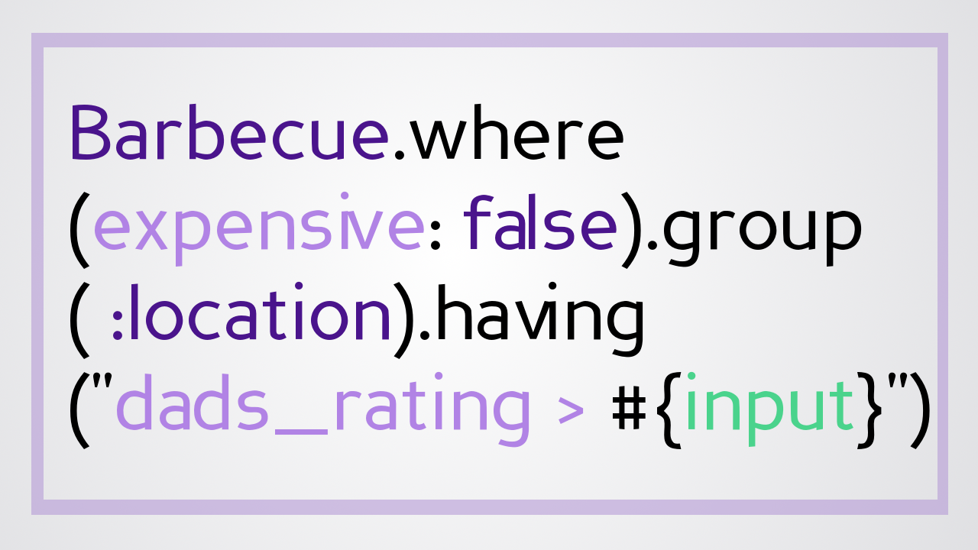
@jessrudder youtube.com/compchomp

Slide 94
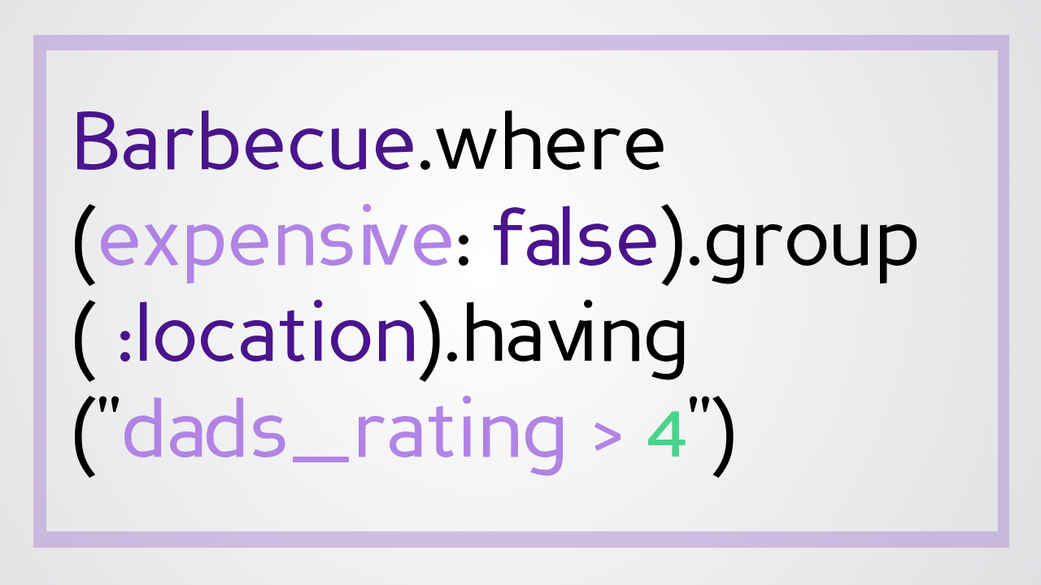
@jessrudder youtube.com/compchomp

Slide 95
@jessrudder youtube.com/compchomp

Slide 96
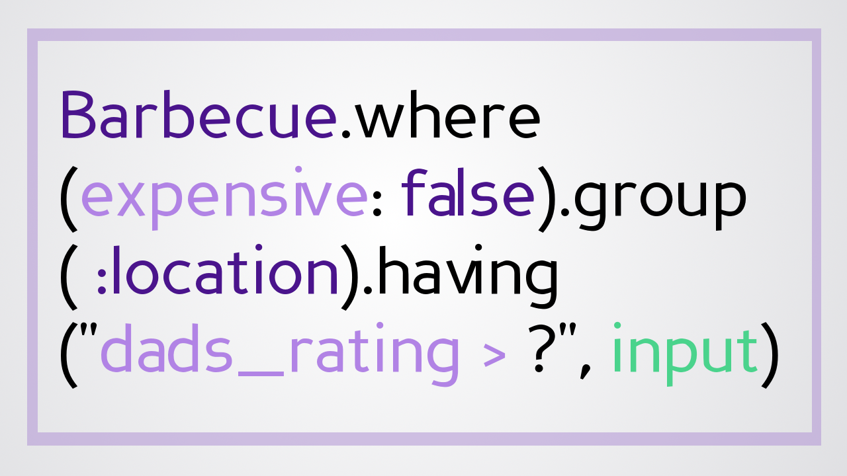
@jessrudder youtube.com/compchomp

Slide 97

@jessrudder youtube.com/compchomp

Slide 98

@jessrudder youtube.com/compchomp

Slide 99

@jessrudder youtube.com/compchomp

Slide 100

@jessrudder youtube.com/compchomp

Slide 101
@jessrudder youtube.com/compchomp

Slide 102

@jessrudder youtube.com/compchomp

Slide 103

@jessrudder youtube.com/compchomp

Slide 104

@jessrudder youtube.com/compchomp

Slide 105
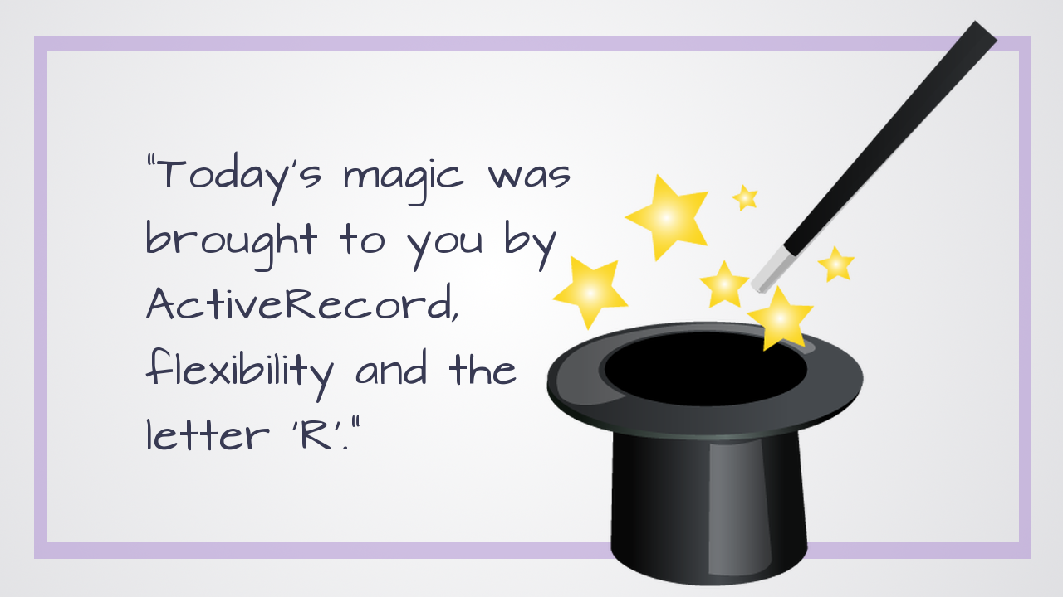
@jessrudder youtube.com/compchomp

Slide 125

@jessrudder youtube.com/compchomp

Slide 126

Notes:
I make videos about code at youtube.com/compchomp – if you like code and videos, I’d love to have you check them out.
I’d also love to continue the conversation - I’m on Twitter @JessRudder
And, I’ve “borrowed” the company credit card and we’ll be having drinks in the Hotel lounge before dinner. Come talk diversity and help me spend some of that NY tech money.
Thank you!

